Slide 1
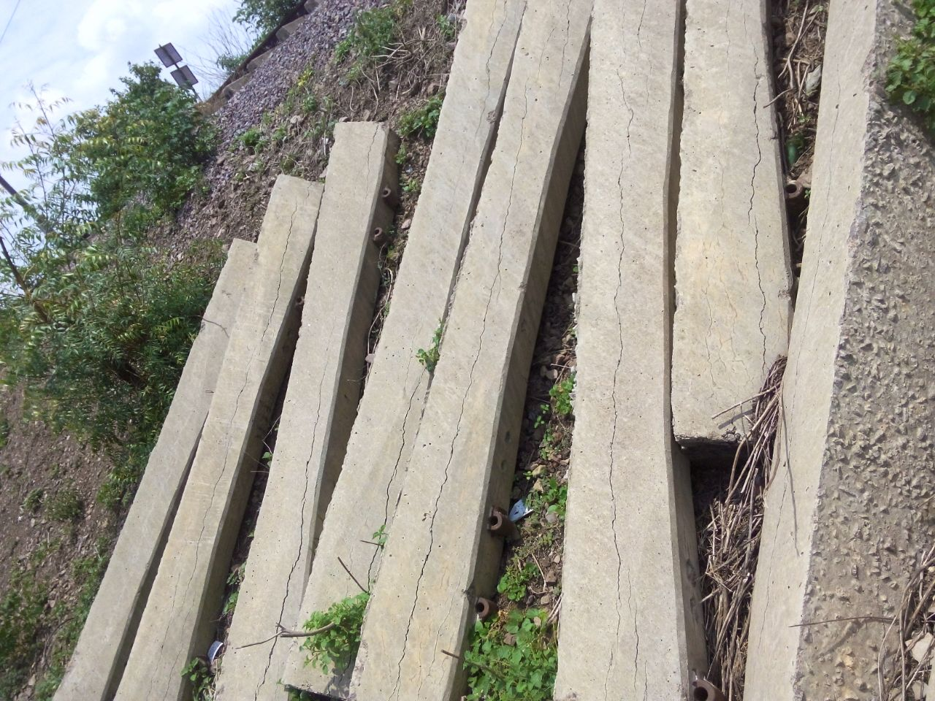


Institution of Permanent Way Engineers
“Study of possible causes of premature cracking of sleepers in Indian Railways”
Anupam Awasthi
Dy. CE/CON/Design & Drawing
ME/ University of Tokyo
Supervisor: Dr. Kohei Nagai
1
Notes:
rs

Slide 2
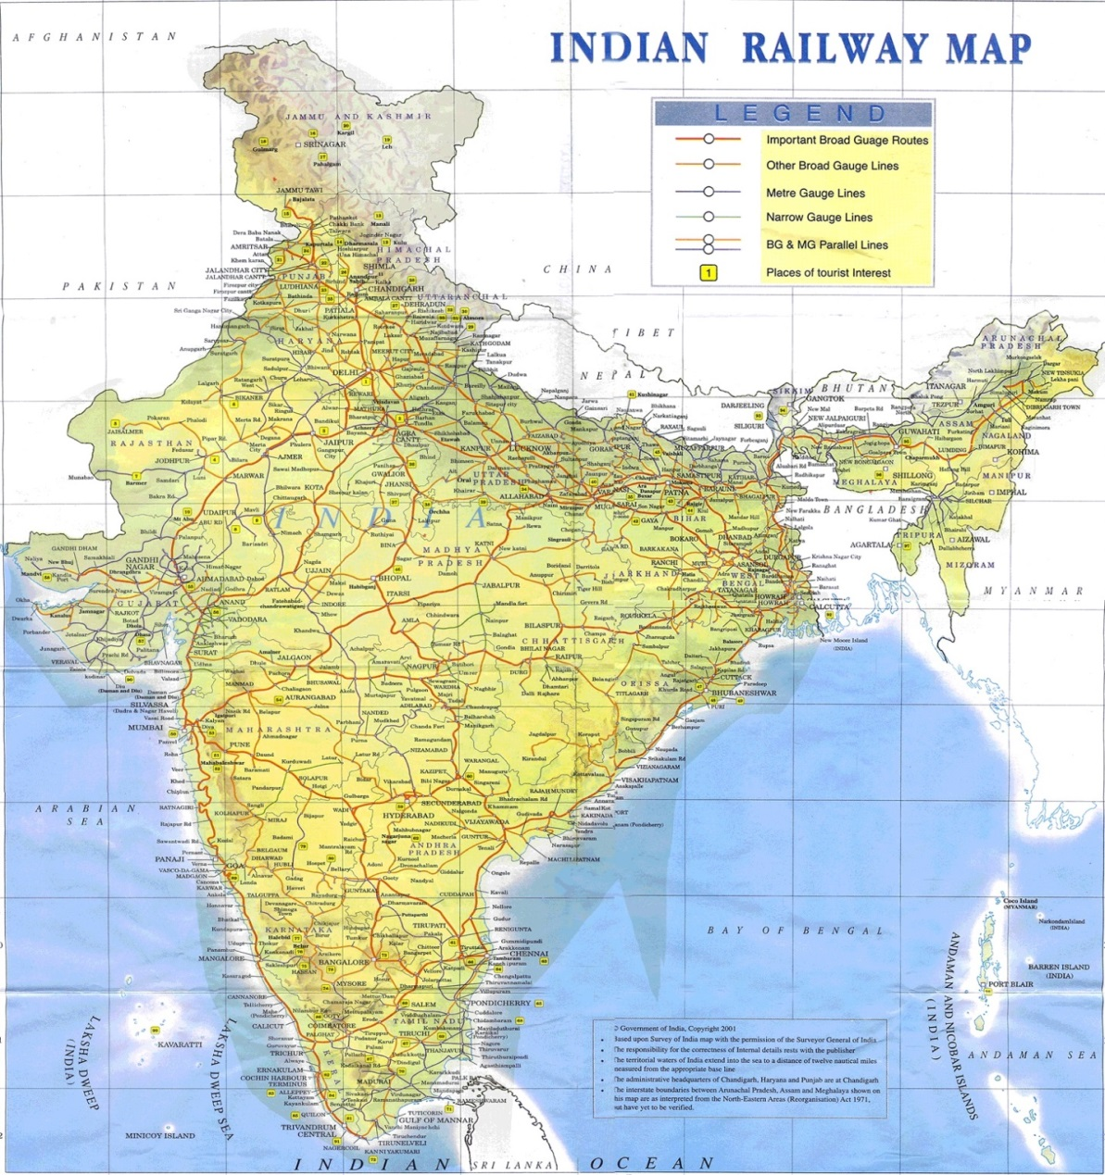
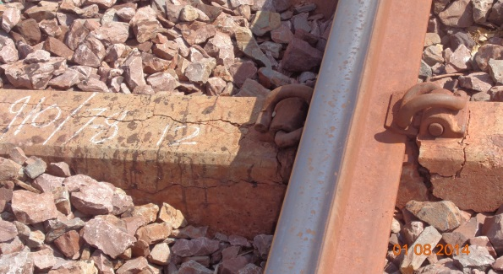
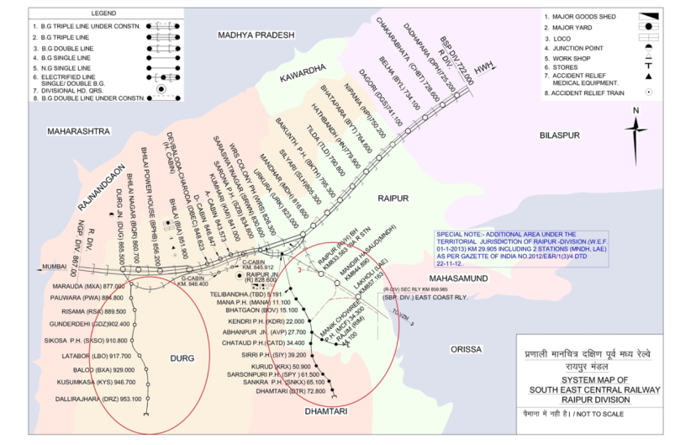
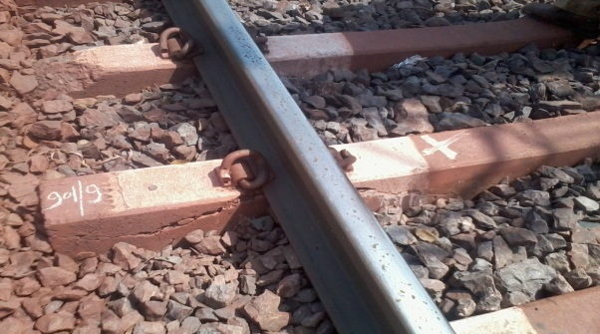
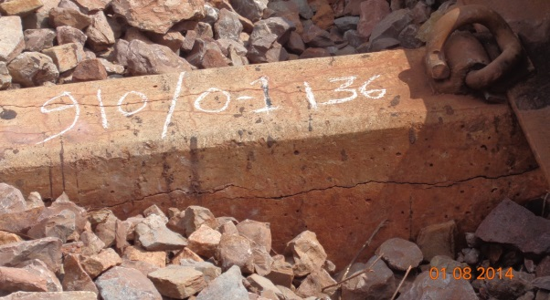
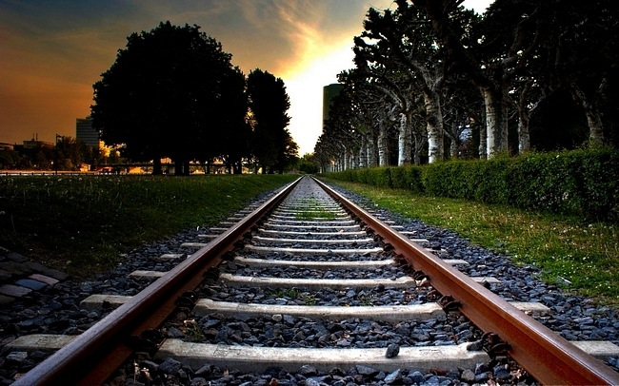
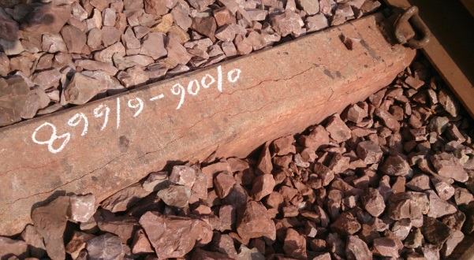
The background
100 KM
Sleeper
Cracking of PSC sleepers starts after 7-8 years.
2

Slide 3
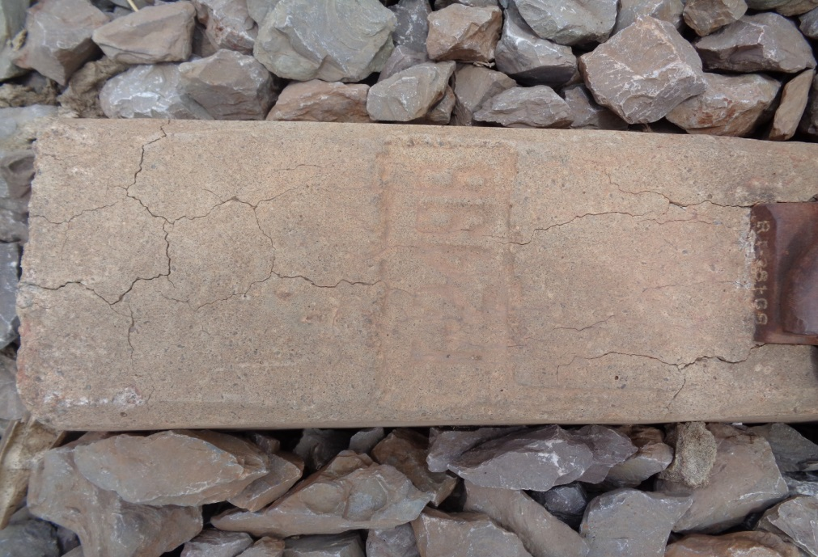
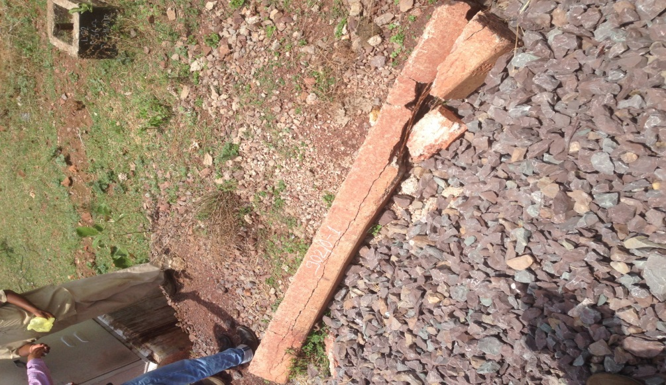


The problem of premature cracking of sleepers
9 years old
12 years old
Map Cracks at the ends
Longitudinal Cracks at middle
Map Cracks without the effect of pre-stress
Longitudinal Cracks due to combined effect of expansion and pre-stress
Top view
Cracking pattern indicates expansive reaction in concrete.
3

Slide 4
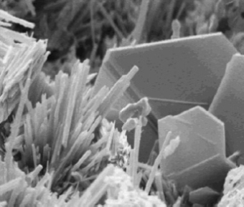
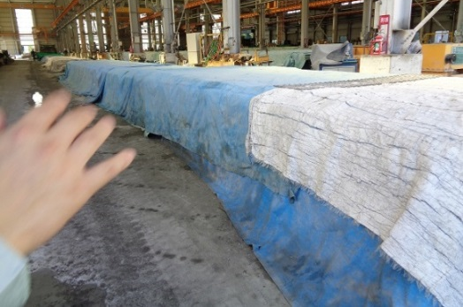
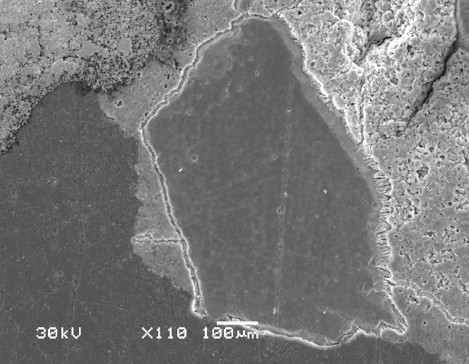
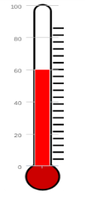
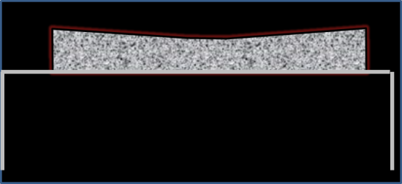
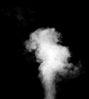
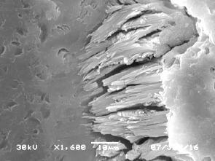
Mechanism of Delayed Ettringite Formation
Primary
Ettringite
C₃A + Gypsum
Water
Water
Monosulfo-aluminate
Ettringite
C₃A
Primary ettringite is good for the concrete
Primary ettringite
Early age temp.
like steam curing
Delayed Ettringite
Decomposition of
Primary Ettringite
Moist Condition
Reformation of Ettringite
Concrete
T>70°C
Delayed ettringite causes deleterious expansion
CHS gel
Ettringite
Ettringite
Ettringite
Aggregate
Ettringite
Delayed Ettringite
Steam curing for
early strength gain
Mechanism of Delayed Ettringite Formation
Early high temperature is a key factor for DEF problem.
4

Slide 5
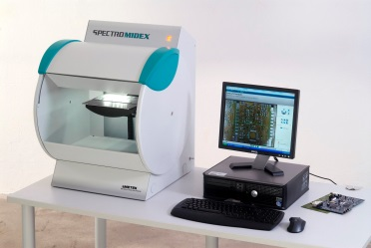
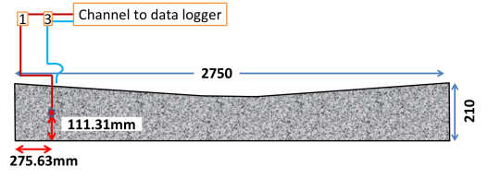
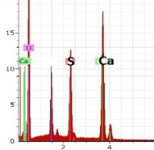
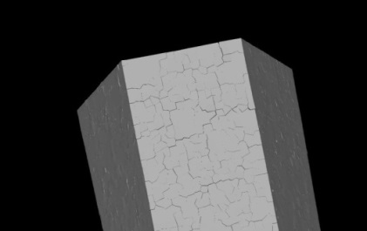
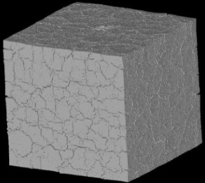
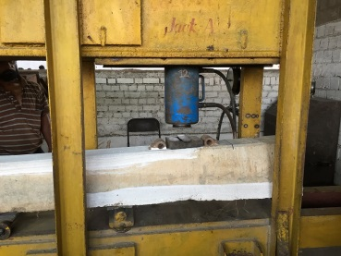


Objectives and flow of the study
Investigation of the problem of premature cracking
1
TOOLS & METHODS
SEM & EDS
XRF
Temperature measurement
Simulation of damage and evaluation of residual capacity
TOOLS & METHODS
2
Damage SIMULATION
ASR & DEF Simulation
EXPERIMENTS
Countermeasures to avoid problem in future
3
Modification in manufacturing process
Overall strength improvement
5

Slide 6
Objectives and flow of the study
Investigation of the problem of premature cracking
1
TOOLS & METHODS
SEM & EDS
XRF
Temperature measurement
Simulation of damage and evaluation of residual capacity
TOOLS & METHODS
2
Damage SIMULATION
ASR & DEF Simulation
EXPERIMENTS
Countermeasures to avoid problem in future
3
Modification in manufacturing process
Overall strength improvement

Slide 7

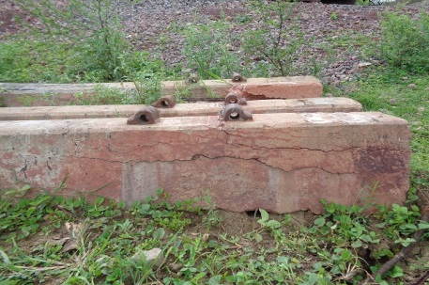
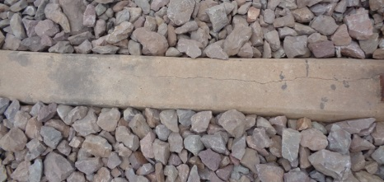
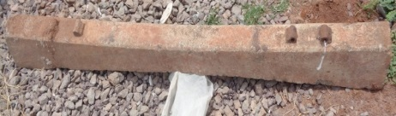
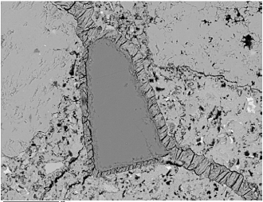
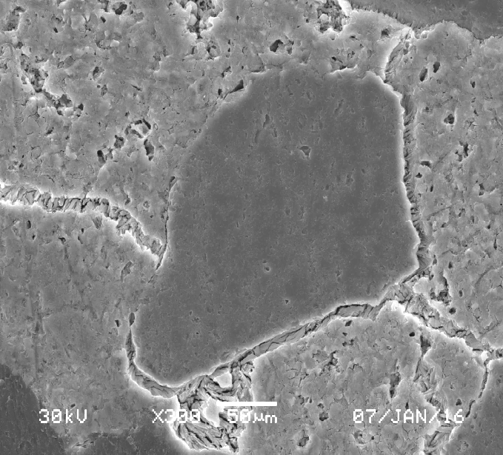
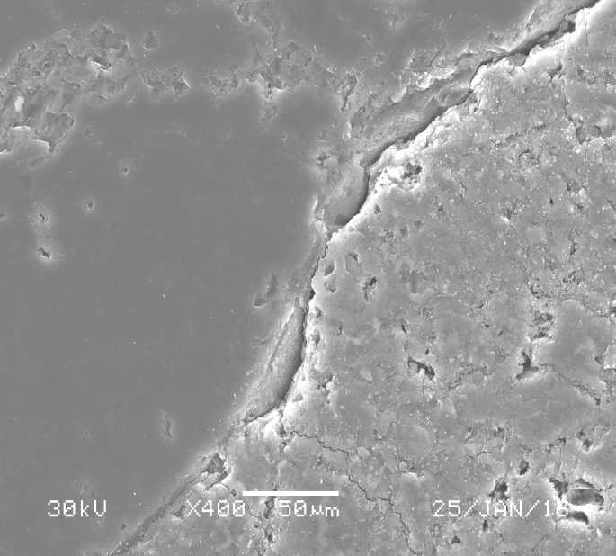
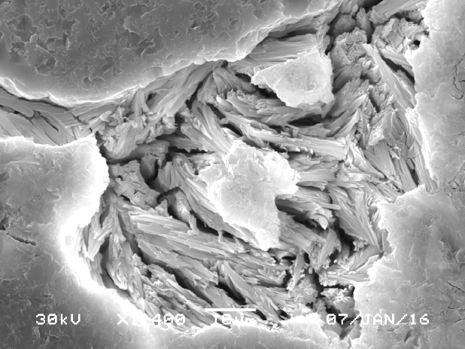
SEM analysis of sleeper samples
1
12 years old
9 years old
21 years old
9 years old
Severely damaged
Moderately damaged
Undamaged
40 Samples of concrete sleepers representing different damage level is collected from India
Damaged sleeper samples shows large ettringite deposits whereas good sleeper sample does not
Severely damaged
Past study of DEF (Thomas et al., 2008)
Undamaged
CHS gel
Aggregate
Ettringite
Aggregate
CSH gel
Aggregate
Ettringite
Enlarged view
CHS gel
Ettringite
Ettringite
Large ettringite deposition noticed in damaged sleepers.
6

Slide 8
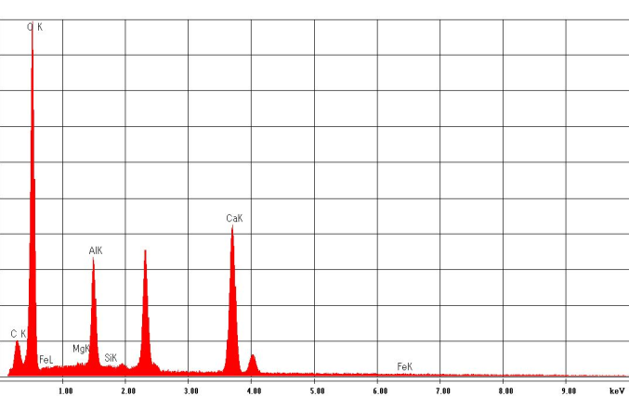
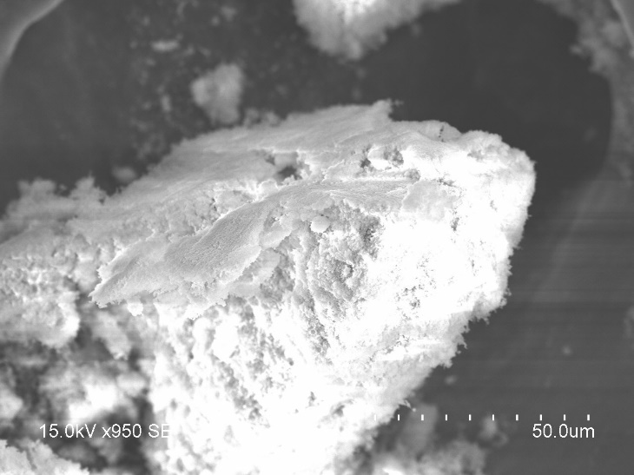
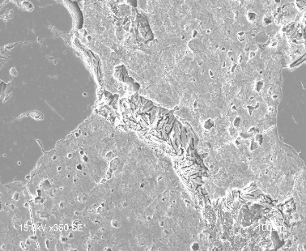
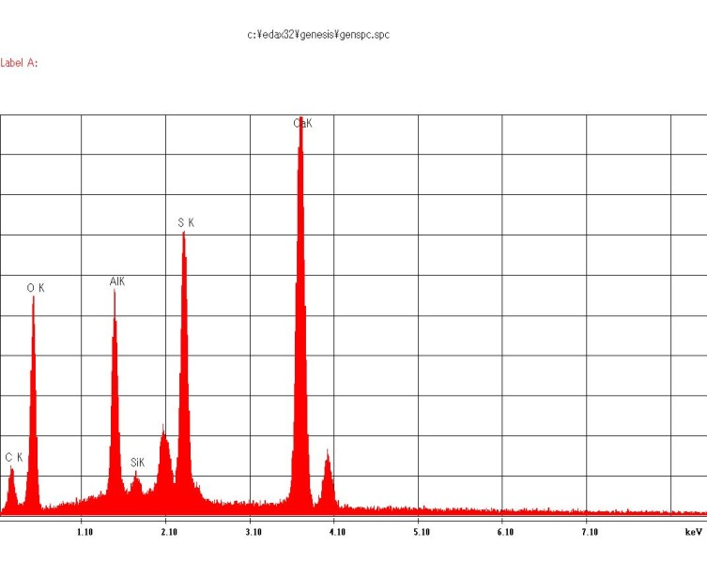
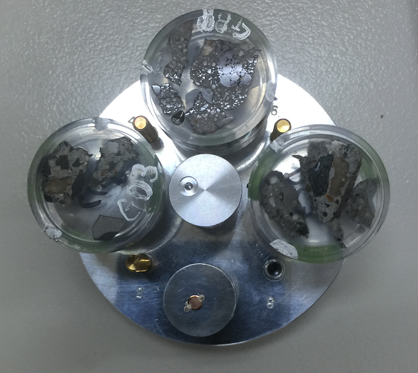
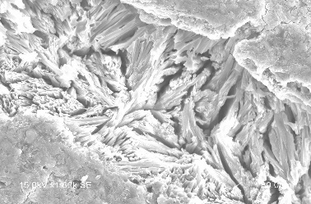
EDS analysis of sleeper samples
1
Synthesised ettringite used for comparison
These three indicates ettringite
Al K
S K
CaK
SiK
1.00
2.00
3.00
4.00
5.00
6.00
7.00
8.00
9.00
keV
Synthesised ettringite
EDS pattern of spot
Ettringite
CaK
Aggregate
S K
Al K
CSH gel
SiK
1.1
2.1
3.1
4.1
5.1
6.1
7.1
keV
Specimen for EDS
SEM Image
EDS pattern of spot: ettringite
EDS analysis confirms the composition of DEF
7
10

Slide 9
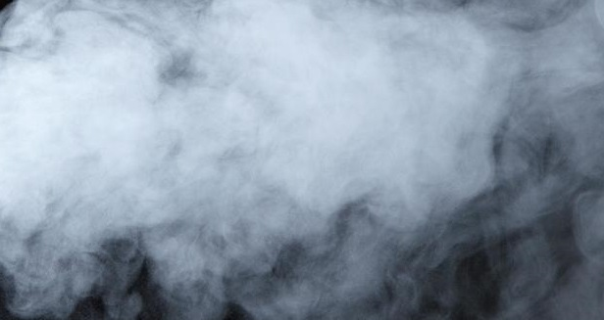
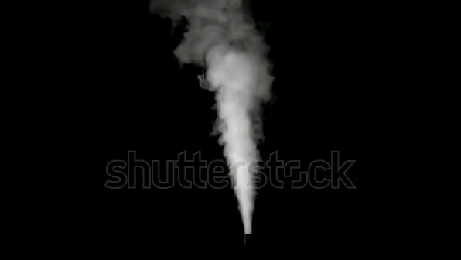
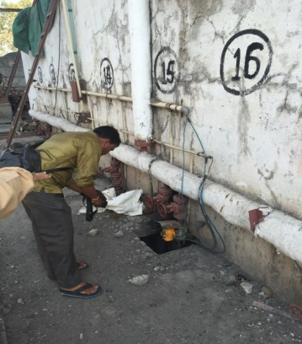
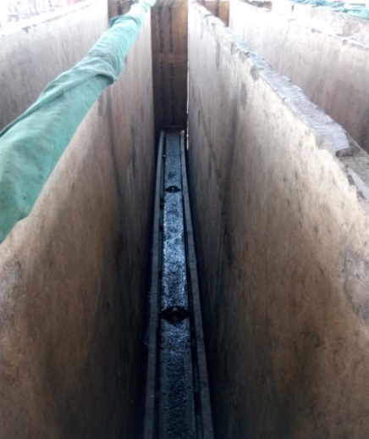
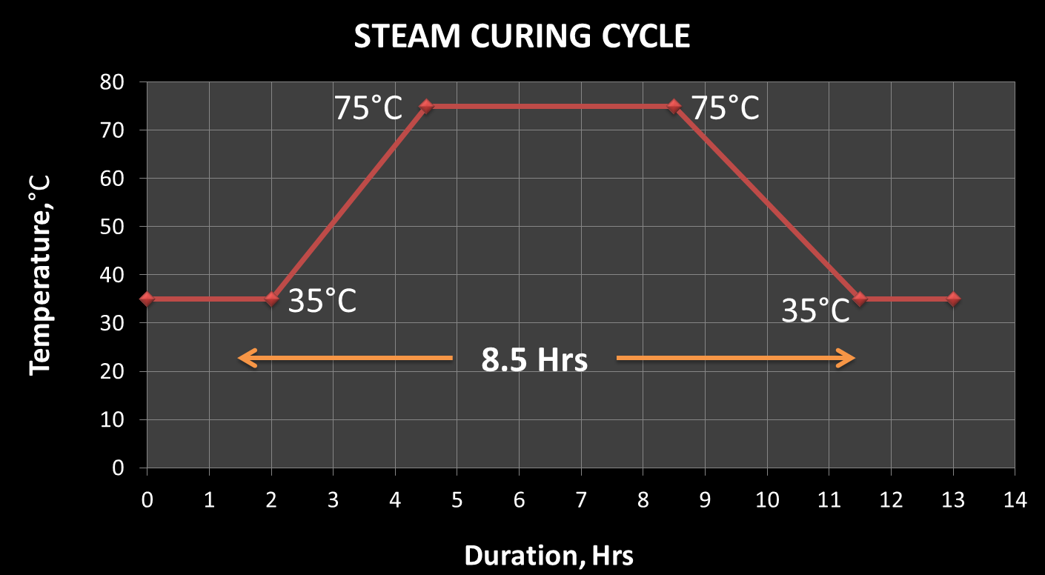
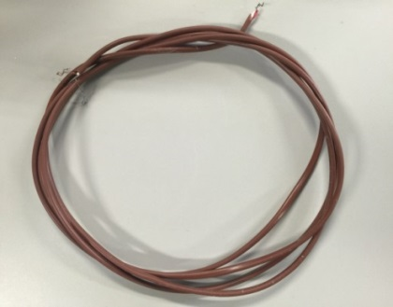
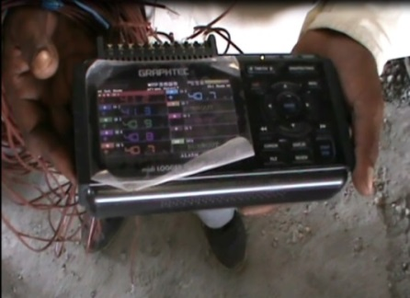
Temperature rise during steam curing
1
Early high temperature of concrete is very important factor for DEF
75 °C
Temperature measurement in India
Sleeper
Curing tank
Steam chamber
STEAM CHAMBERS
Steam
Steam pipes
Thin wall
Thermocouples
Data logger
Maximum curing temperature 75°C may trigger DEF
8

Slide 10
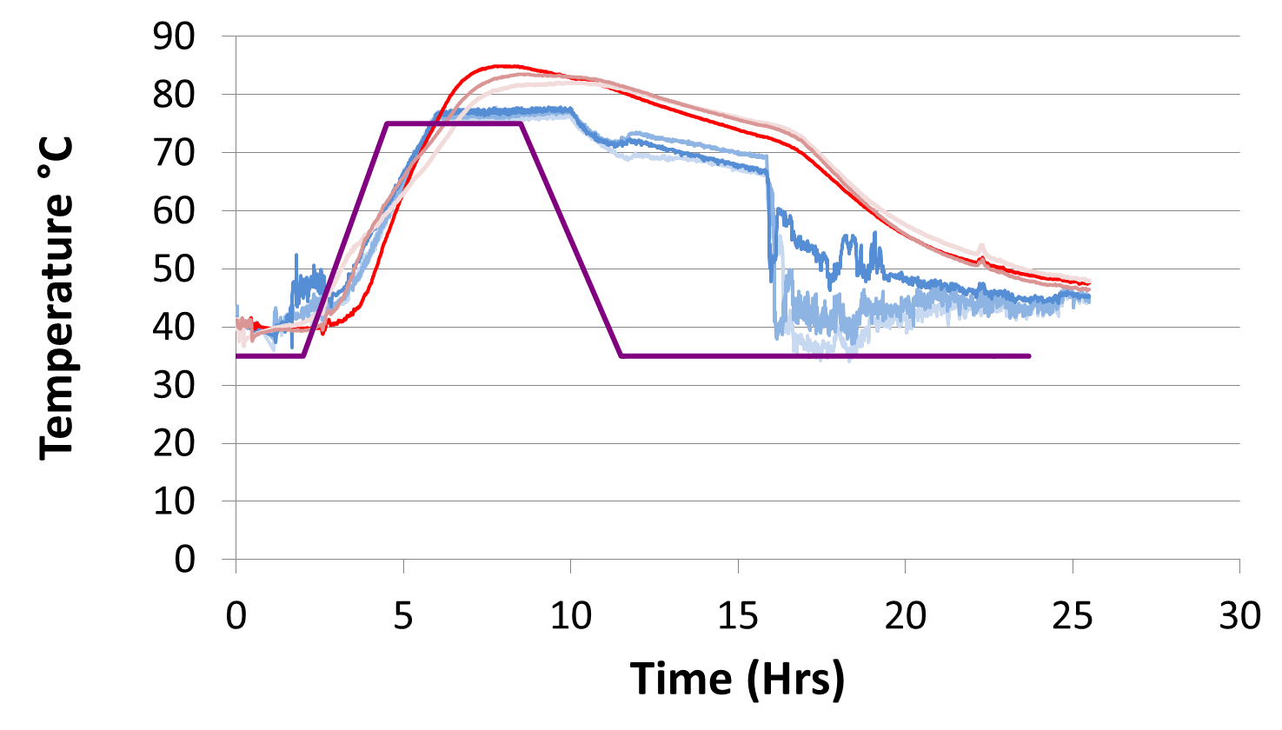
Temperature measurement in India
1
Results of field measurement of temperature
Maximum Inside temperature = 84.9 °C
Critical temperature for DEF
Temperature inside concrete
Temperature outside concrete
Cooling cycle is excessively prolonged
Set curing cycle
Temperature rise inside the concrete 84.9 °C, is very critical for DEF.
9

Slide 11
Objectives and flow of the study
Investigation of the problem of premature cracking
1
TOOLS & METHODS
SEM & EDS
XRF
Temperature measurement
Simulation of damage and evaluation of residual capacity
TOOLS & METHODS
2
Damage SIMULATION
ASR & DEF Simulation
EXPERIMENTS
Countermeasures to avoid problem in future
3
Modification in manufacturing process
Overall strength improvement

Slide 12
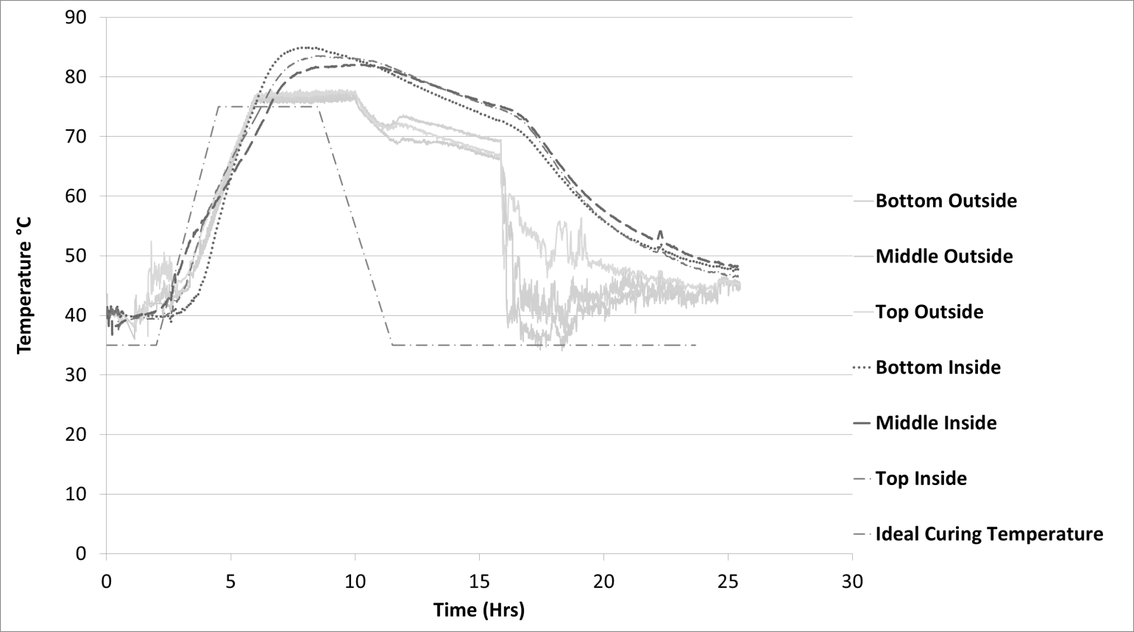
3
Countermeasures for pre-mature cracking
Limit the maximum temperature inside the concrete below 70°C.
Trial curing cycles may be conducted to decide optimum
temperature.
①
②
Critical temperature for DEF
De-moulding strength = 40 MPa
Example of trial curing cycle
Expected temperature inside the concrete
Maximum concrete temperature below 70°C is safe for DEF problem
10

Slide 13

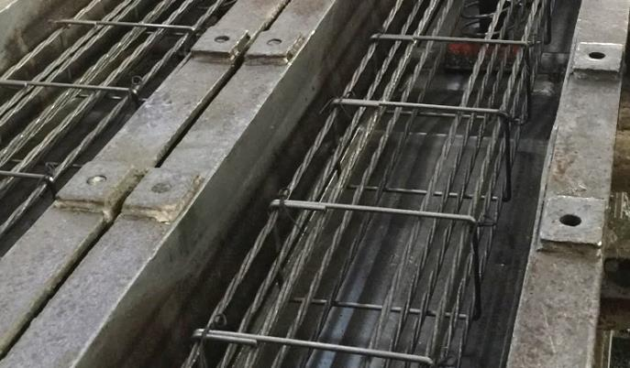
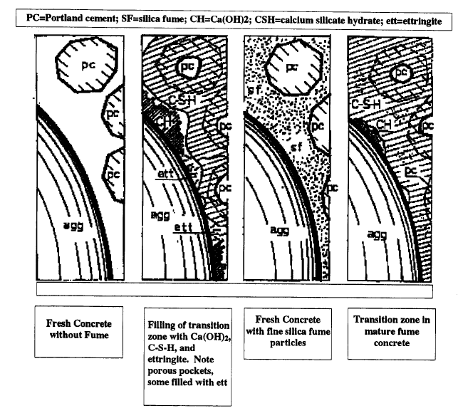
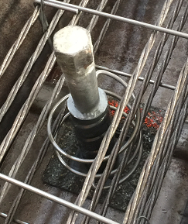
3
Countermeasures for pre-mature cracking
③
④
Bending cement with silica fume or slag to
improve interface characteristics
Provision of extra reinforcement like
stirrups & spiral reinforcement at inserts
SEM image showing damage in interface
Aggregate
Stirrups provide confinement to the core concrete and resist expansive forces
Silica fume provide extra silica required for the hydration
Spiral reinforcement can resist failure at inserts
Other countermeasures proposed for overall improvement
11
24

Slide 14
Conclusions
Investigations
Simulation
3
1
2
Countermeasures
Investigation reveals large ettringite deposition in the damaged sleepers of Indian Railways
Field measurement of temperature reveals that sleepers experiences high early age temperature (> 80°C ), which is very critical for DEF problem to occur in future
Pre-stress is successfully introduced in RBSM model
Structural scale simulation of cracking pattern does not yield localised longitudinal cracks observed in field
Material scale simulation of ASR agrees well with the field observation but DEF does not indicating other mechanism might be taking place in concrete
Countermeasure is suggested to limit maximum concrete temperature up to 70°C.
Blending cement with slilica fume or slag can improve interface characteristics
Stirrups and extra spiral reinforcement around insert can improve overall strength
Unique feature of the study: direct practical application of the results and findings.
12

Slide 15
Previous publications…
The research work is selected for “Furuichi Award-2016” by the University of Tokyo which is given for best masters thesis.
The research work has been presented at “Asian Concrete Federation-2016” meet at Hanoi, Veitnam
Two International publications of research work:
1. Anupam Awasthi, Kohei Nagai, Shingo Asamoto and Seishi Goto, “Study of possible causes of premature cracking of sleepers in Indian Railways”, Asian Concrete Federation,2016 conference proceeding – abstracts p 86.
2. Liyanto Eddy, Anupam Awasthi, Koji Matsumoto, Kohei Nagai and Shingo Asamoto Mesoscopic, “Analysis of different expansion causes in concrete by 3D Rigid Body Spring Model” New Technologies for Urban Safety of Mega Cities in Asia, November 2016, Tacloban, Philippines
Thank you very much for your kind attention
anupamawasthi1978@gmail.com(Mob:9752440219)
13
Notes:
rs

Slide 16
Appendix

Slide 17
Objectives and flow of research
Investigation of the problem of premature cracking
1
TOOLS & METHODS
SEM & EDS
XRF
Temperature measurement
Simulation of damage and evaluation of residual capacity
TOOLS & METHODS
2
Damage SIMULATION
ASR & DEF Simulation
EXPERIMENTS
Countermeasures to avoid problem in future
3
Modification in manufacturing process
Overall strength improvement
5

Slide 18
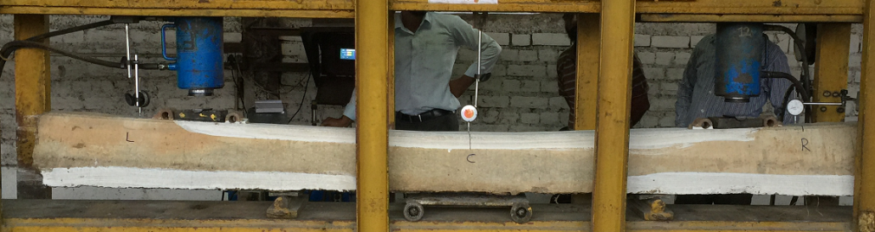
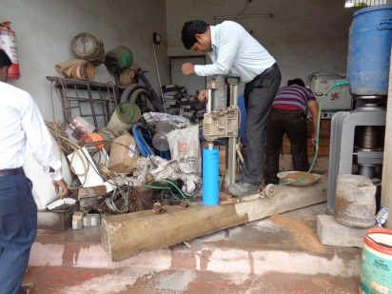






2
Residual capacity of sleepers
Static Bending Test
Compressive Strength Test
Undamaged
Severely damaged
Severely damaged
Undamaged
100%
170%
Percentage of 15 days target mean strength = 67.86 MPa
Bending capacity (KN)
50%
Compressive strength (MPa)
51%
Undamaged
Severely damaged
Undamaged
Severely damaged
Damaged sleeper shows considerable reduction of strength
10

Slide 19











2
Simulation of damage by discrete analysis
Structural scale simulation
Material scale simulation
3
2
Top Surface
Concrete
Steel
1
Mortar
Aggregate
3
2
1
Predicted failure pattern
Observed failure pattern
RBSM is very effective for simulation of cracking pattern in concrete
Dimensions of the sleeper (mm)
150
235
2750
270
Z
Z
Y
Y
PC strands
Section at middle
1375mm
Front face
X
Concrete element
X
Section of model at the ends
Section of model at the middle
Structural scale simulation is performed by RBSM
11

Slide 20





2
Simulation of pre-stress
Transfer length (L_{t} ) is the length required at the ends of pre-tensioned member for the build up of stress in concrete
Tensile stress induced by initial strain
Transfer length, L_{t}
Transfer length, L_{t}
Steel
ε_{i}
ε_{i}
Input initial strain
Variable initial strain is introduced to steel elements
Concrete
Stress at bottom fiber
Bottom elements
Compressive stress
Tensile stress
Variable stress in concrete at the ends representing transfer length
12
Pre-stressing force in sleeper is introduced successfully
19

Slide 21










2
Simulation of expansion in concrete
=> Content of paste in the concrete ~ 23%
Simulation of 20% expansion of random faces is conducted after pre-stress
Pre-stress
20%
Actual case, Ends
Simulation result, Ends
Actual case, Middle
Simulation result, Middle
Simulation of smaller material scale is necessary to pin point the problem
Simulation does not produce localised cracks in the middle portion
13

Slide 22




2
Material scale simulation of DEF and ASR
2
150mm
150mm
: JSCE
: Analysis
150 mm
150mm
150mm
150mm
Mortar model
Aggregate model
Random expanding mortar faces
Mechanism of ASR
Random expanding aggregates
Mechanism of DEF
Simulation of DEF expansion
Simulation of ASR expansion
ASR gel
Ettringite
ASR gel
DEF: mortar face expansion, ASR: aggregate interface expansion
14

Slide 23






2
Simulation of ASR and DEF
Aggregate Interface Expansion (ASR)
Simulation, 25% aggregate expansion
Actual cracking pattern
Matching
Crack view
Internal stress
ASR damage
Mortar Expansion (DEF)
Simulation, 25% mortar expansion
Actual cracking pattern
Not Matching
Crack view
Internal stress
DEF damage
Based on Paste Expansion Theory →cracks are caused by only expansion in cement paste
Crystal Growth Theory → Another mechanism of DEF: cracks are caused by the pressure at the interface
Other mechanism may take place in case of DEF damage in concrete
15

Slide 24


Temperature measurement in India
1
Cover
Data logger
Rising steam
Steam pipes
Curing tank
Steam Chambers
Thin wall
Steam
Steam Chamber
Arrangement of curing chambers
Three sleepers are selected for temperature measurement
13

Slide 25



Temperature measurement in India
1
①
Workers issue
Area depicts heat energy
②
Effect of Thin wall
Thin wall
Workers issue and thin wall of curing chamber affects cooling curve
9
16

Slide 26


DEF
ESA
ISA
Traditional sulphate attack
New phenomenon detected in 1980s in Railway sleepers
Traditional approach
Destruction of primary ettringite> reformation when exposed to water > influence of ASR
?
Holistic approach

Slide 27


Portland Cement Association

Slide 28

Comparison to mean strength 67.86 N/mm2
New Good Sleeper, 2012
Old Good Sleeper, 1992
Relatively New Cracked Sleeper, 2005
80%
170%
65.4%
Relatively New Cracked Sleeper, 2005
51%
Notes:
New good: 7A OCS 12RT 2496 1393 19.7.12
Old good: OCAL 92 32 A A-12 52 Kg Balod
Relatively New Cracked Sleeper: RCS 05 4183 303D Wide Gauge Curve Sleeper
Relatively New Cracked Sleeper: RCS 05 4183 314 Wide Gauge Curve Sleeper

Slide 29
Comparison of Cement and Process of steam curing
Parameters | Unit | As per IS 12269-1987 for Early High Strength cement | Indian Sleeper plant values | Composition at which problem of DEF Noticed in European countries | New German Guidelines issued to solve the problem of DEF | Japanese sleepers Plant Values
SO3 | % | 3.5 max | 2.22-2.35 | 4 |  | 2.96 (Max 3.08)
C3A | % | 10 max | 7.5-8.04 | 8 | 12
Fineness | Sq m /kg | 370 min | 375.7-380.3 | 460-480 |  | 441 (SD 91)
Cement Content | Kg/cum |  | 453.17 | 400 |  | 448
W/C ratio |  |  | 0.33 | 0.36-0.39 |  | 0.342
Delay period | Hrs |  | 2.0 | 1-2 | 4 | 3
Max Temperature | °C |  | 75 | 75-80 | 60 | 50
Soaking period | Hrs |  | 9.5 | 2.5-4.0
One day Strength | MPa |  | 42.89 | 43-56 | 68 | 40
Rate of Temp rise | °C/ Hr |  | 16 |  | 10-15 | 15
Max size of aggregate | mm |  | 20 |  | 16 | 20
Yellow Colour shows the venerable values in case of Indian PSC sleepers which may cause damage

Slide 30


  SEM differences
DEF
ASR

Slide 31

SEM image
Aggregate
Aggregate
C-H-S gel
old Good sleeper

Slide 32

Close up sem image
Aggregate
C-H-S gel
old Good sleeper

Slide 33

EDS image & results
Bruker Nano GmbH, Germany |  |  |  | 2015/08/31
 | Quantax
Results | 1015
Date: | 2015/08/31
Element | [wt.%] | [norm. wt.%] | [norm. at.%] | Compound | [norm. wt.%] | Error in wt.% (3 Sigma)
Oxygen | 19.6002 | 36.71020563 | 56.75379207 |  | 1.84637E-15 | 6.741330188
Aluminium | 0.50419302 | 0.944328608 | 0.865701493 | Al2O3 | 1.784274613 | 0.15129767
Sulfur | 0.12394375 | 0.232140516 | 0.17906797 | SO3 | 0.579621552 | 0.093346849
Calcium | 25.3718022 | 47.52013126 | 29.32806097 | CaO | 66.49047878 | 2.344241111
Silicon | 7.70930108 | 14.43913982 | 12.71659788 | SiO2 | 30.89016071 | 1.040181606
Magnesium | 0.08225213 | 0.154054168 | 0.156779611 | MgO | 0.255464341 | 0.093411144
Sum: | 53.3916921 | 100 | 100
old Good sleeper

Slide 34



Specimen of More damaged sleeper
More damaged sleeper manufactured in 2002

Slide 35

SEM IMAGE -1
Ettringite
Large deposition of ettringite
Aggregate
Ettringite
More damaged sleeper

Slide 36


Close up
Aggregate
Ettringite
C-H-S gel
More damaged sleeper

Slide 37

SEM IMAGE -2
C-H-S gel
C-H-S gel
Large ettringite deposit
More damaged sleeper

Slide 38


Close up
Ettringite (needle like structure )
More damaged sleeper

Slide 39

EDS image & results
Bruker Nano GmbH, Germany |  |  |  | 2015/08/31
 | Quantax
Results | sleeper1.spx
Date: | 2015/08/31
Element | [wt.%] | [norm. wt.%] | [norm. at.%] | Compound | [norm. wt.%] | Error in wt.% (3 Sigma)
Sulfur | 8.563695 | 12.64118 | 9.356461 | SO3 | 31.5632 | 0.998346
Calcium | 26.04977 | 38.453 | 22.77158 | CaO | 53.80369 | 2.426149
Aluminium | 5.246524 | 7.744583 | 6.812401 | Al2O3 | 14.63311 | 0.821572
Oxygen | 27.88445 | 41.16124 | 61.05956 |  | -1.9E-15 | 9.972725
Sum: | 67.74444 | 100 | 100
More damaged sleeper

Slide 40




Specimen of less damaged sleeper
less damaged sleeper manufactured in 2005

Slide 41

SEM IMAGE -1
Ettringite
less damaged sleeper

Slide 42

EDS image & results
Bruker Nano GmbH, Germany |  |  |  | 2015/08/31
 | Quantax
Results | 1013
Date: | 2015/08/31
Element | [wt.%] | [norm. wt.%] | [norm. at.%] | Compound | [norm. wt.%] | Error in wt.% (3 Sigma)
Oxygen | 28.4734 | 41.03691 | 60.98522 |  | 5.86E-18 | 10.29794
Aluminium | 5.228539 | 7.535562 | 6.640527 | Al2O3 | 14.23817 | 0.819253
Sulfur | 8.725868 | 12.57604 | 9.325086 | SO3 | 31.40057 | 1.015624
Calcium | 26.95705 | 38.85149 | 23.04917 | CaO | 54.36126 | 2.507154
Sum: | 69.38486 | 100 | 100
less damaged sleeper

Slide 43

SEM IMAGE -2
C-H-S gel
C-H-S gel
Ettringite
Aggregate
C-H-S gel
less damaged sleeper

Slide 44


Close up
Ettringite (needle like structure )
less damaged sleeper

Slide 45

EDS image & results
Bruker Nano GmbH, Germany |  |  |  | 2015/08/31
 | Quantax
Results | 1012
Date: | 2015/08/31
Element | [wt.%] | [norm. wt.%] | [norm. at.%] | Compound | [norm. wt.%] | Error in wt.% (3 Sigma)
Oxygen | 35.64355 | 47.60912 | 64.32635 |  | 1.53E-15 | 13.06488
Aluminium | 3.175559 | 4.241597 | 3.398327 | Al2O3 | 8.014343 | 0.538584
Sulfur | 4.906416 | 6.553504 | 4.418056 | SO3 | 16.36316 | 0.620333
Calcium | 13.51907 | 18.05743 | 9.739853 | CaO | 25.26608 | 1.322536
Silicon | 17.62247 | 23.53835 | 18.11742 | SiO2 | 50.35642 | 2.290259
Sum: | 74.86706 | 100 | 100
less damaged sleeper

Slide 46
Curing
INDIAN
JAPANESE
Max temp 75°C
After steam curing water curing for 14 days
Separate Steam chambers
Max temp 50°C
No water curing
Steam brought through pipes at the place of casting

Slide 47


JAPANESE SLEEPER PLANT Pipe line carrying steam for curing

Slide 48

JAPANESE SLEEPER PLANT curing in situ in long line

Slide 49

INDIAN SLEEPER PLANT Curing chambers

Slide 50
Reinforcement
INDIAN
JAPANESE
No extra reinforcement other than pre-stressing tendons
Tendons are not ribbed
Only pre-tensioned
Stress bench method
Extra reinforcement near insert and extra transverse reinforcement
Ribbed tendons
Both pre and post tensioned
Long line method

Slide 51


JAPANESE SLEEPER PLANT Extra helical reinforcement around insert and extra transverse reinforcement

Slide 52

JAPANESE SLEEPER PLANT Ribbed tendons

Slide 53


JAPANESE SLEEPER PLANT Both post- tensioned and pre-tensioned

Slide 54


INDIAN SLEEPER PLANT stress bench method
JAPANESE SLEEPER PLANT long line method

Slide 55
Strength Testing
INDIAN
JAPANESE
Only bending test
Bending test and Insert pulling test

Slide 56

INDIAN SLEEPER PLANT Bending test

Slide 57


JAPANESE SLEEPER PLANT Bending and Insert pulling tests

Slide 58
Concreting
INDIAN
JAPANESE
Weigh batching automatic but not computerised
Advanced and Computerised batching plant

Slide 59




INDIAN SLEEPER PLANT concrete mixing & placing

Slide 60


JAPANESE SLEEPER PLANT concrete mixing & placing

Slide 61
Special mortar application at the face
INDIAN
JAPANESE
Only bituminous painting and no mortar
Special mortar is applied

Slide 62



INDIAN SLEEPER No mortar curing at the end
JAPANESE SLEEPER special mortar curing

Slide 63
Heavier section
INDIAN
JAPANESE
Total weight 270 Kg
Total weight 300 kg

Slide 64


INDIAN SLEEPER DESIGN for Broad Gauge 1673 mm
JAPANESE SLEEPER DESIGN for Shinkansen Standard Gauge 1435 mm

Slide 65


Slide 66

Delayed ettringite formation in Swedish concrete railroad ties
Unexpected, steam curing < 60°C
Produced between 1992 to 1996
Map cracking in 1999

Slide 67

Samples
  Cracked
  Uncracked
Examination
  Visual and stereo optical microscopy
  Scanning Electron Microscope with EDS
Nature of crack or sign of deposit
Examination of deposit

